Slide 1










Current Landscape
The time required to undertake an environmental health study is substantial
Analyses are fit-for-purpose and often start with a data audit.
Data sets are mostly siloed, i.e., used for one project and stored away offline.
No national digital representation of environmental and health indicators at a local level.
Departments do not have the resources to undertake data scoping and acquisition.
Value of such an infrastructure only recently understood due to emergence of spatial atlases, digital twins, etc.
For more: https://frontiersi.com.au/ausenhealth-digital-twin/

Slide 2
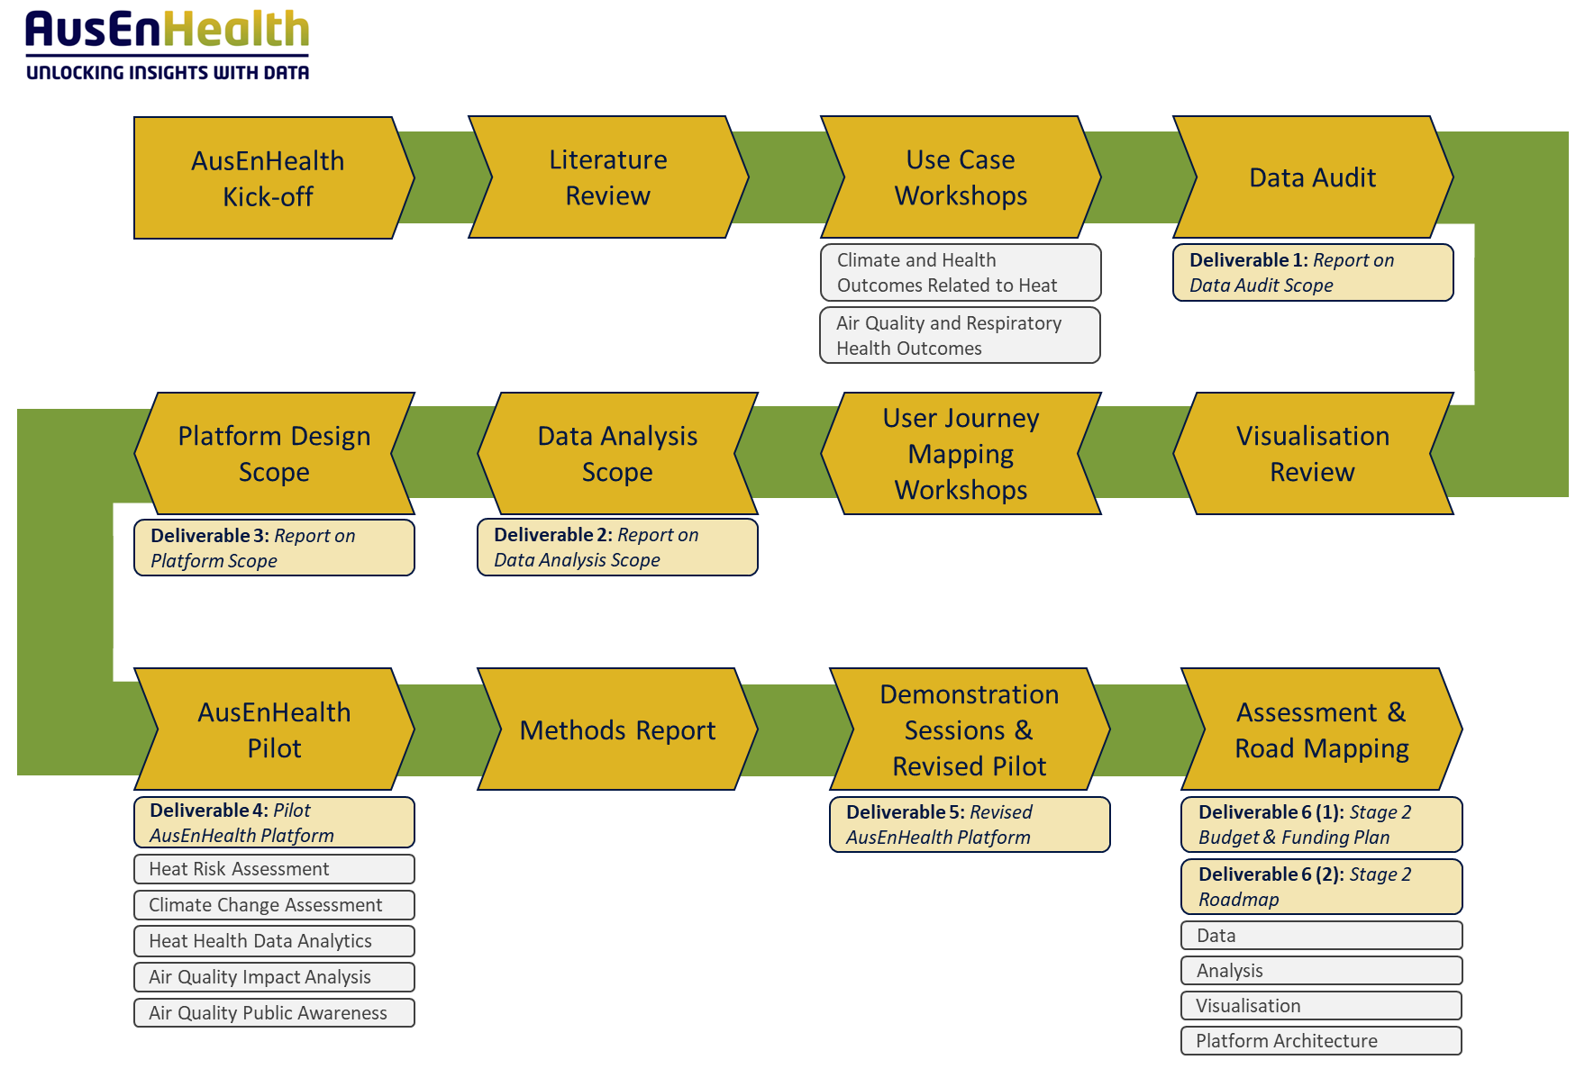
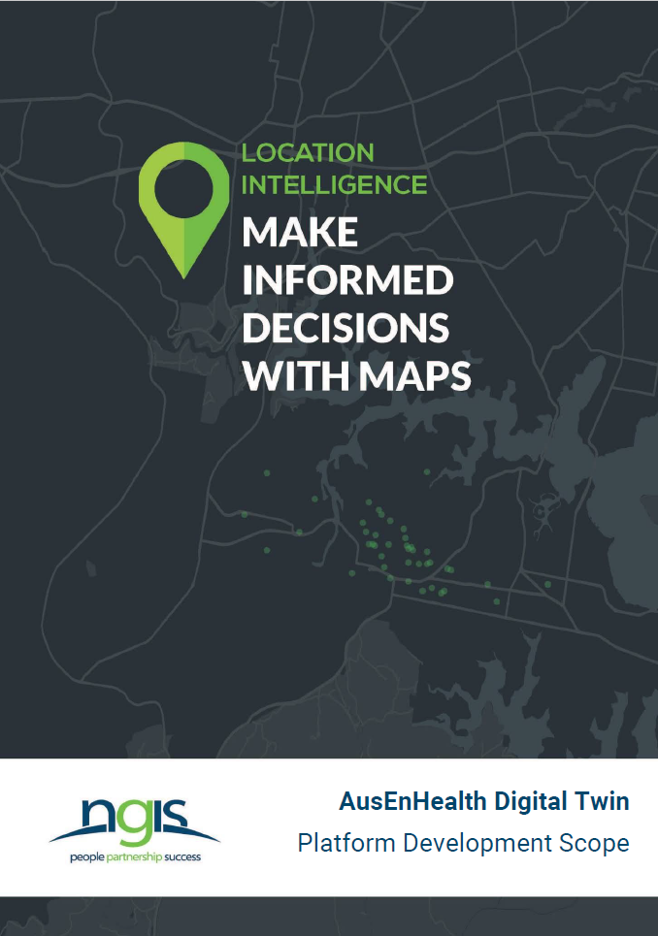

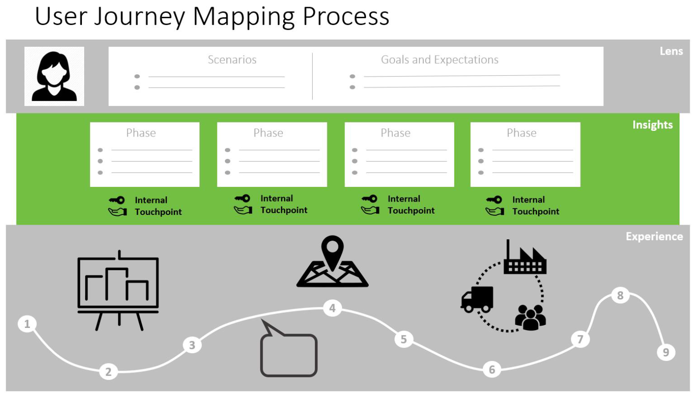
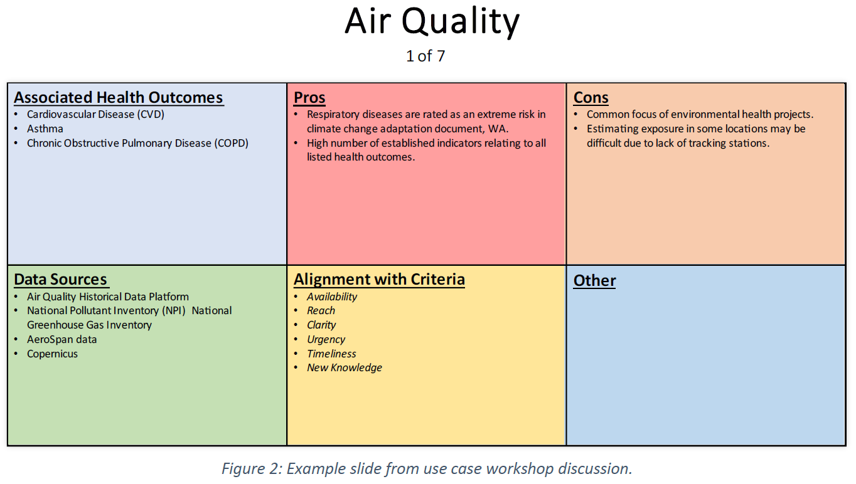
Solution: AusEnHealth
Collaborate with the environmental health community.
Develop a national infrastructure.
Enable access to government, researchers, and the public. That is, open access.
Resolve access, visualisation, and even analysis barriers.
Provide clear documentation, e.g., metadata, technical reports, to allow for reproduction and validation.

Slide 3
Where We’re At: Data Access
183 environmental health variables (Temporal: 2000-2020 | Spatial: with geographies ranging from gridded to State level)
Exposure Theme | Raw Data Variables from data custodians (n=55) | Variables created for AusEnHealth (n=94) | Indicators (n=22) | Vulnerability Indices (n=12)
 | Raw data from range of custodians (e.g., BOM, NASA, AIHW) | Derivatives from manipulation of raw data variables | Thresholds related to adverse health risks | These indices combine many variables (incl. population demographics, health service locations, health risk indicators and conditions, and vegetation cover with use case parameters of interest to give a single value which represents region-specific population risk.
Heat | Min temp Max temp | Average temperature Excess heat factor | The number of “at risk” temperature days – 85th percentile | Heat vulnerability Index
Air Quality | PM 2.5 | Average PM2.5 | Number of days average particulate matter (<2.5μm) exceeded the overall average. | Air quality vulnerability index

Slide 4
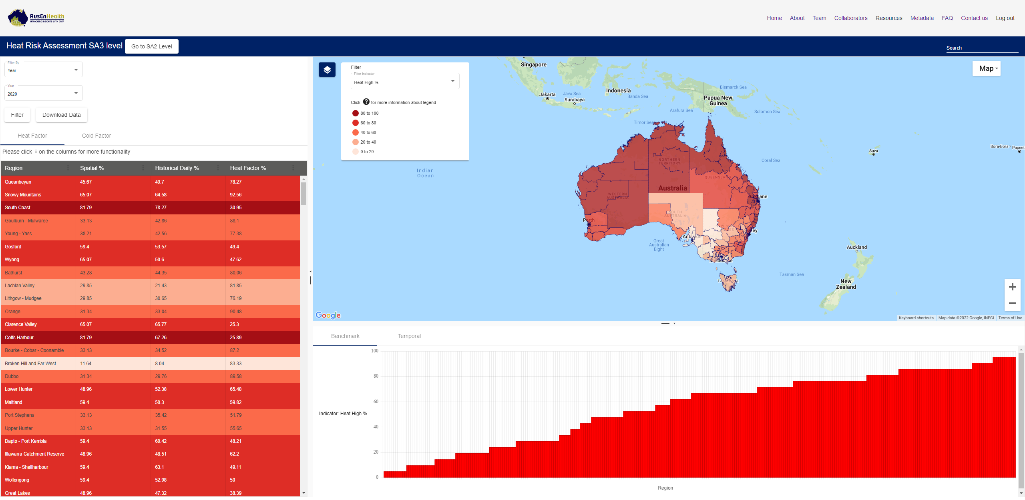
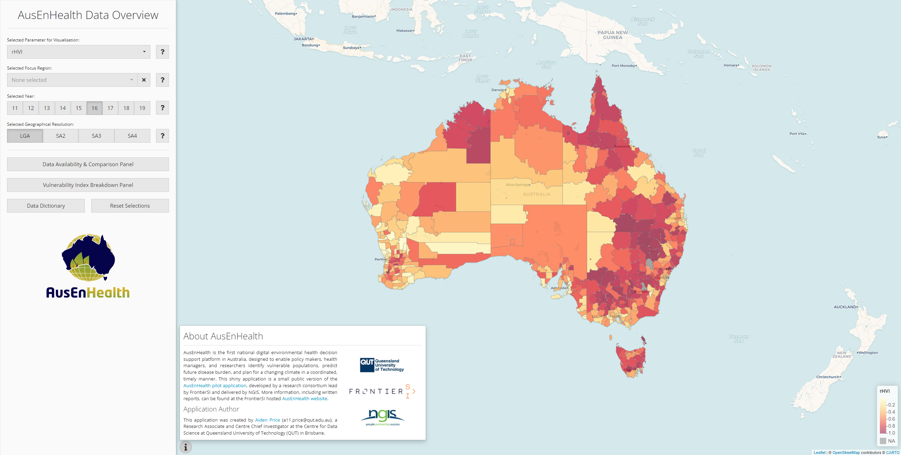
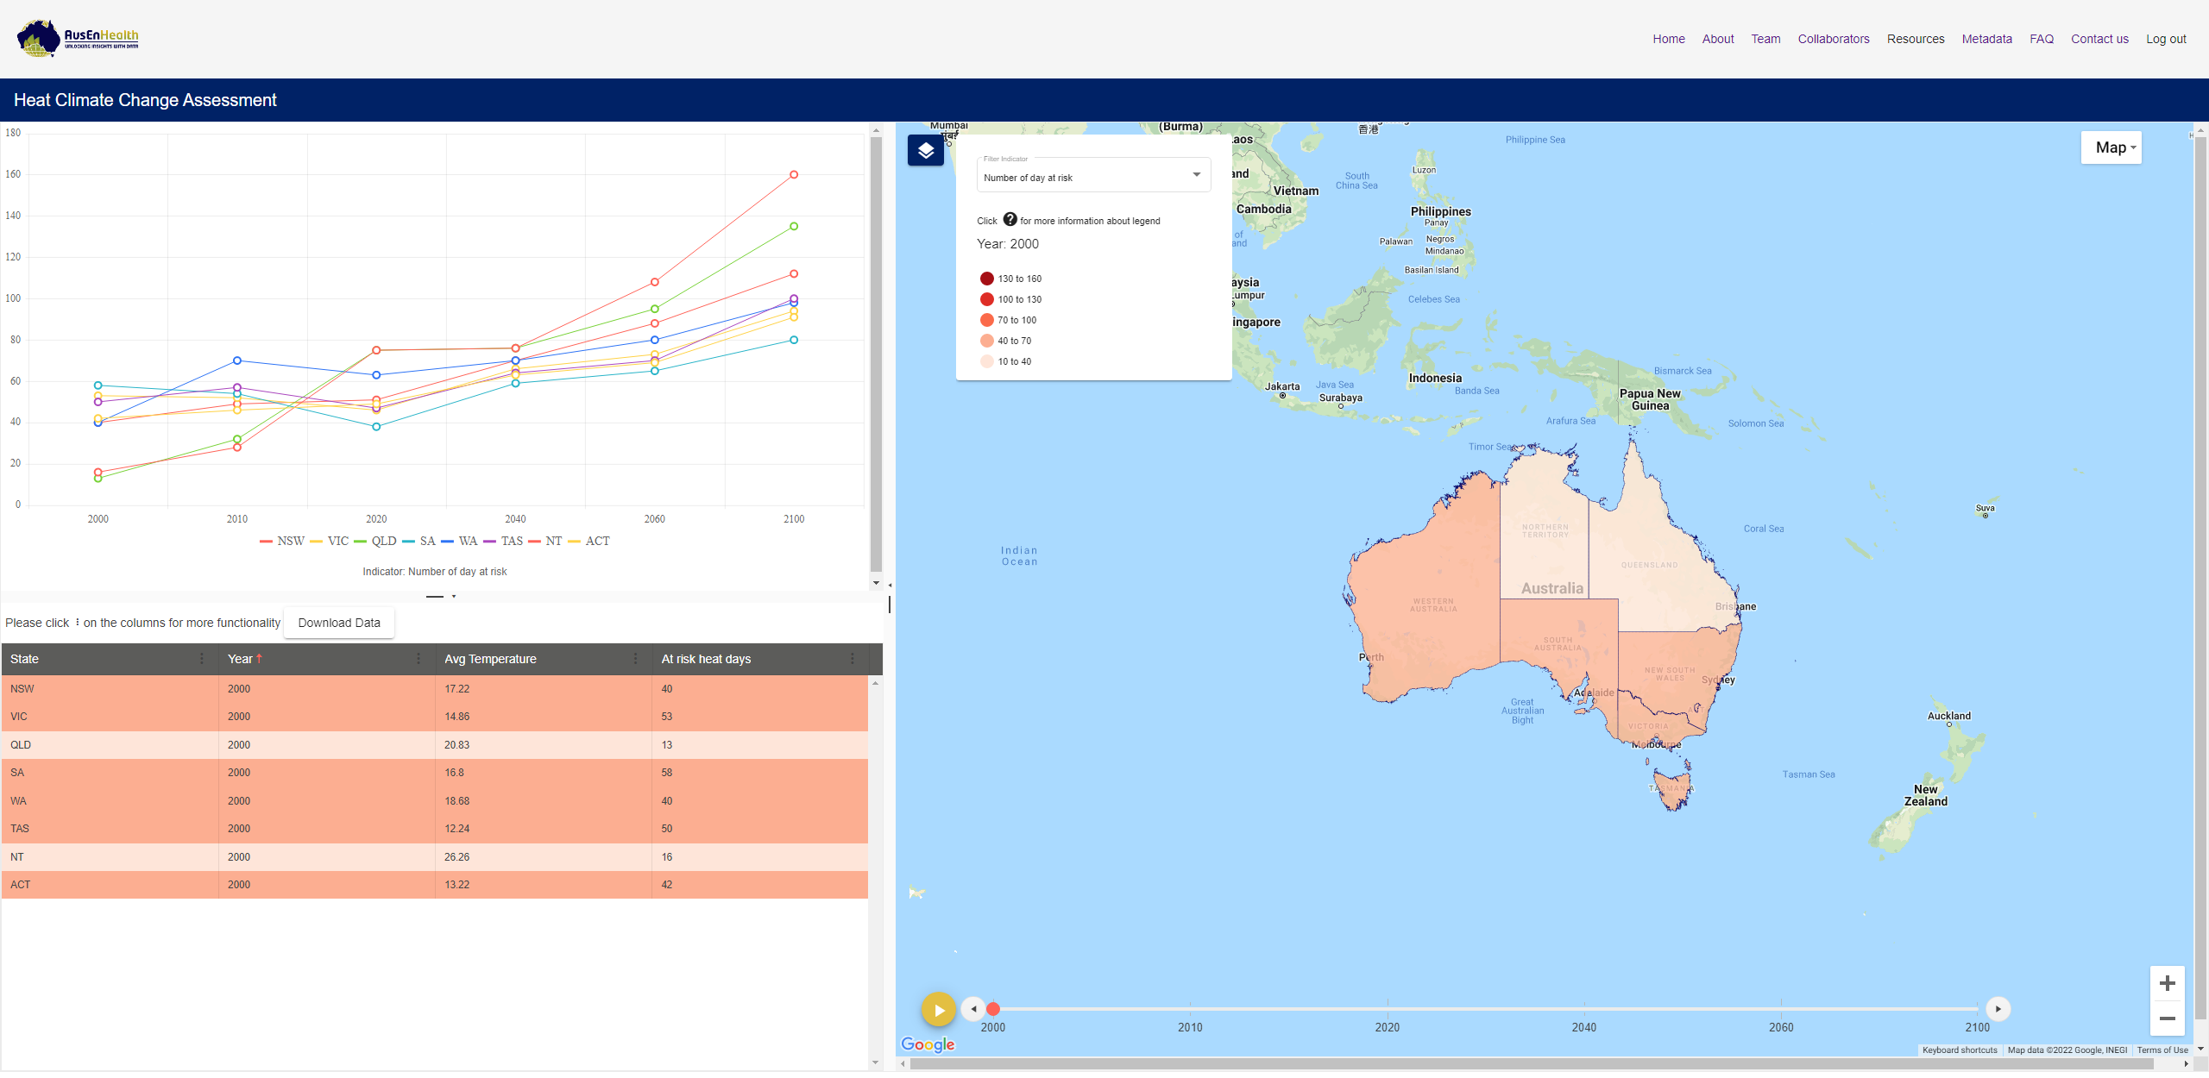
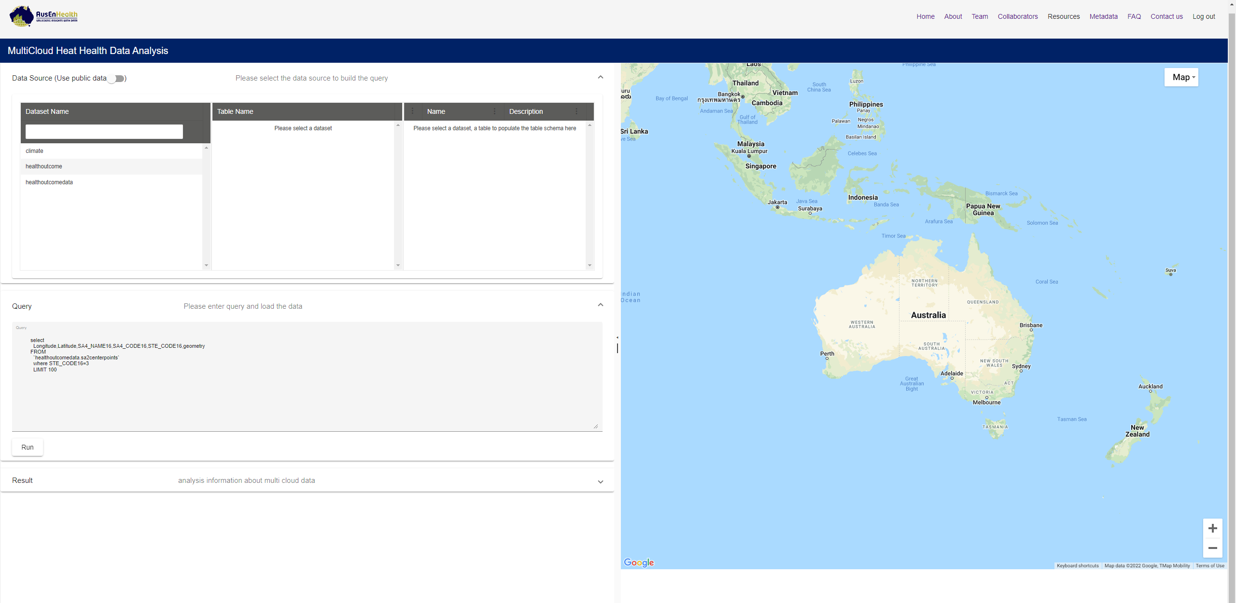
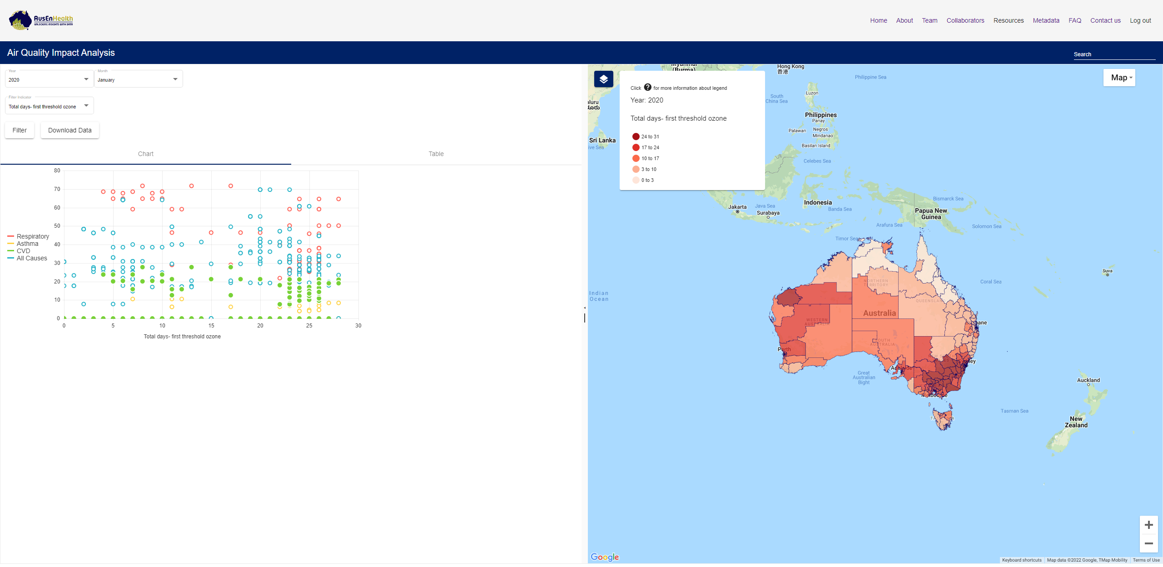
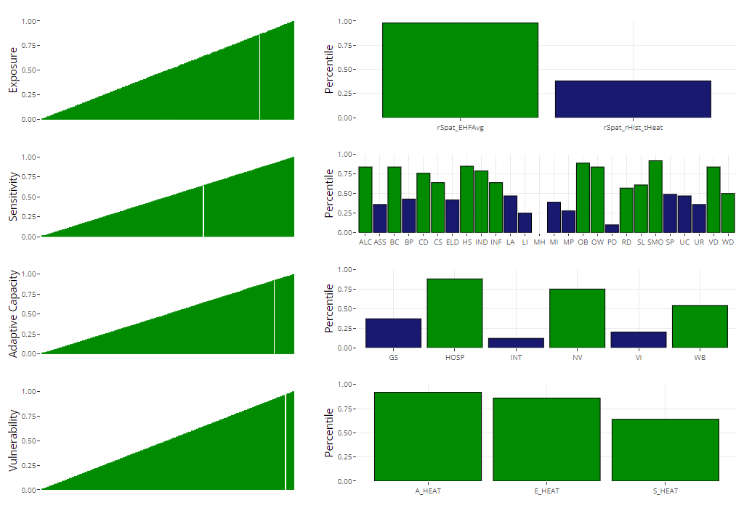
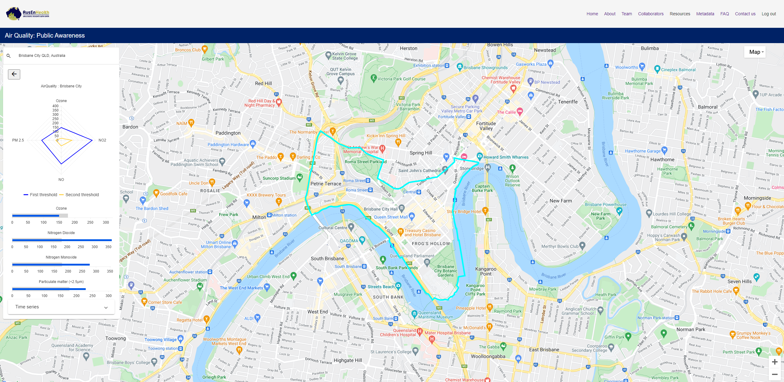
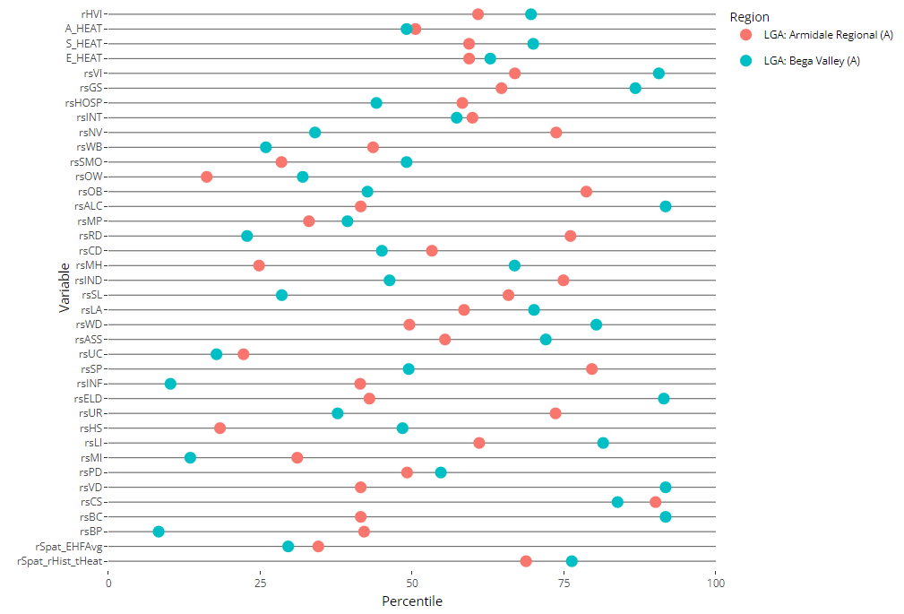
Where We’re At: National Infrastructure
See more: https://qutcds.shinyapps.io/AusEnHealth_Interactive/

Slide 5
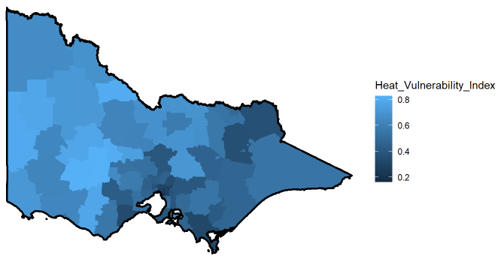
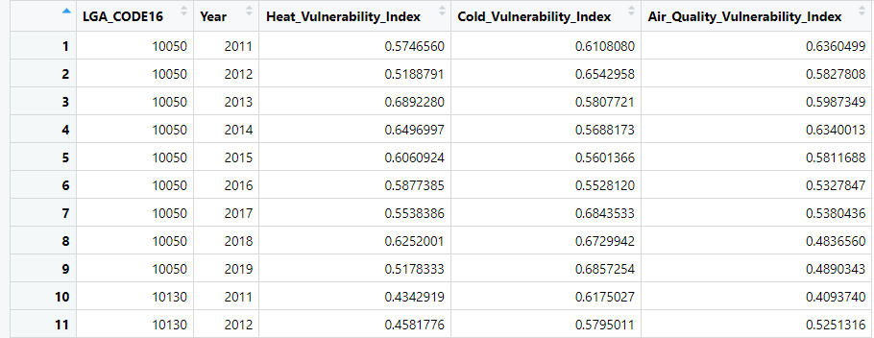
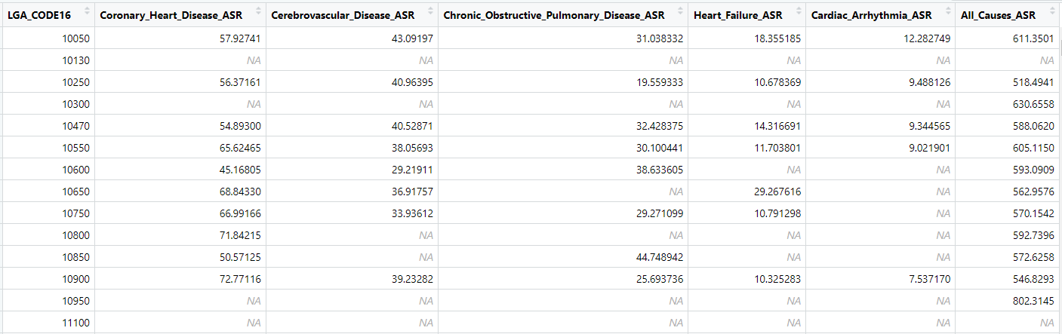
We’re providing national LGA region boundaries (shape files) to help you with visualisations.
Where You Come In
AusEnHealth is designed to help answer a wide range of environmental health questions.
Today, we want to focus on how our vulnerability indices and collected mortality data can be used to support researchers and decision makers.
Resources:
We’re providing national heat, cold, and air quality vulnerability indices.
We’re providing mortality data; national averages from the Australian Institute of Health and Welfare.
Local Government Area Resolution
(ASGS2016)
Month / Year / Week Temporal Resolution
2011-2019
Temporal Extent
Local Government Area Resolution
(ASGS2016)
Single Time Point
(5yr Averages)
Missing Data Entries

Slide 6

Bayes on the Beach - Potential Directions
Which areas are most at risk?
Can we use vulnerability indices to make predictions about mortality?
What (if any) are the spatial/temporal patterns in the data?
Which areas look like other areas, e.g., are there clusters?
Data, sample code and these slides can be found at AusEnHealth’s QUT Centre for Data Science GitHub page: https://github.com/QUTCDS/AusEnHealth/
Or alternatively, use this QR code:
Or alternatively again, ask around to find a physical copy of the data on a USB drive.

